Slide 1
NU Car Rental

Slide 2
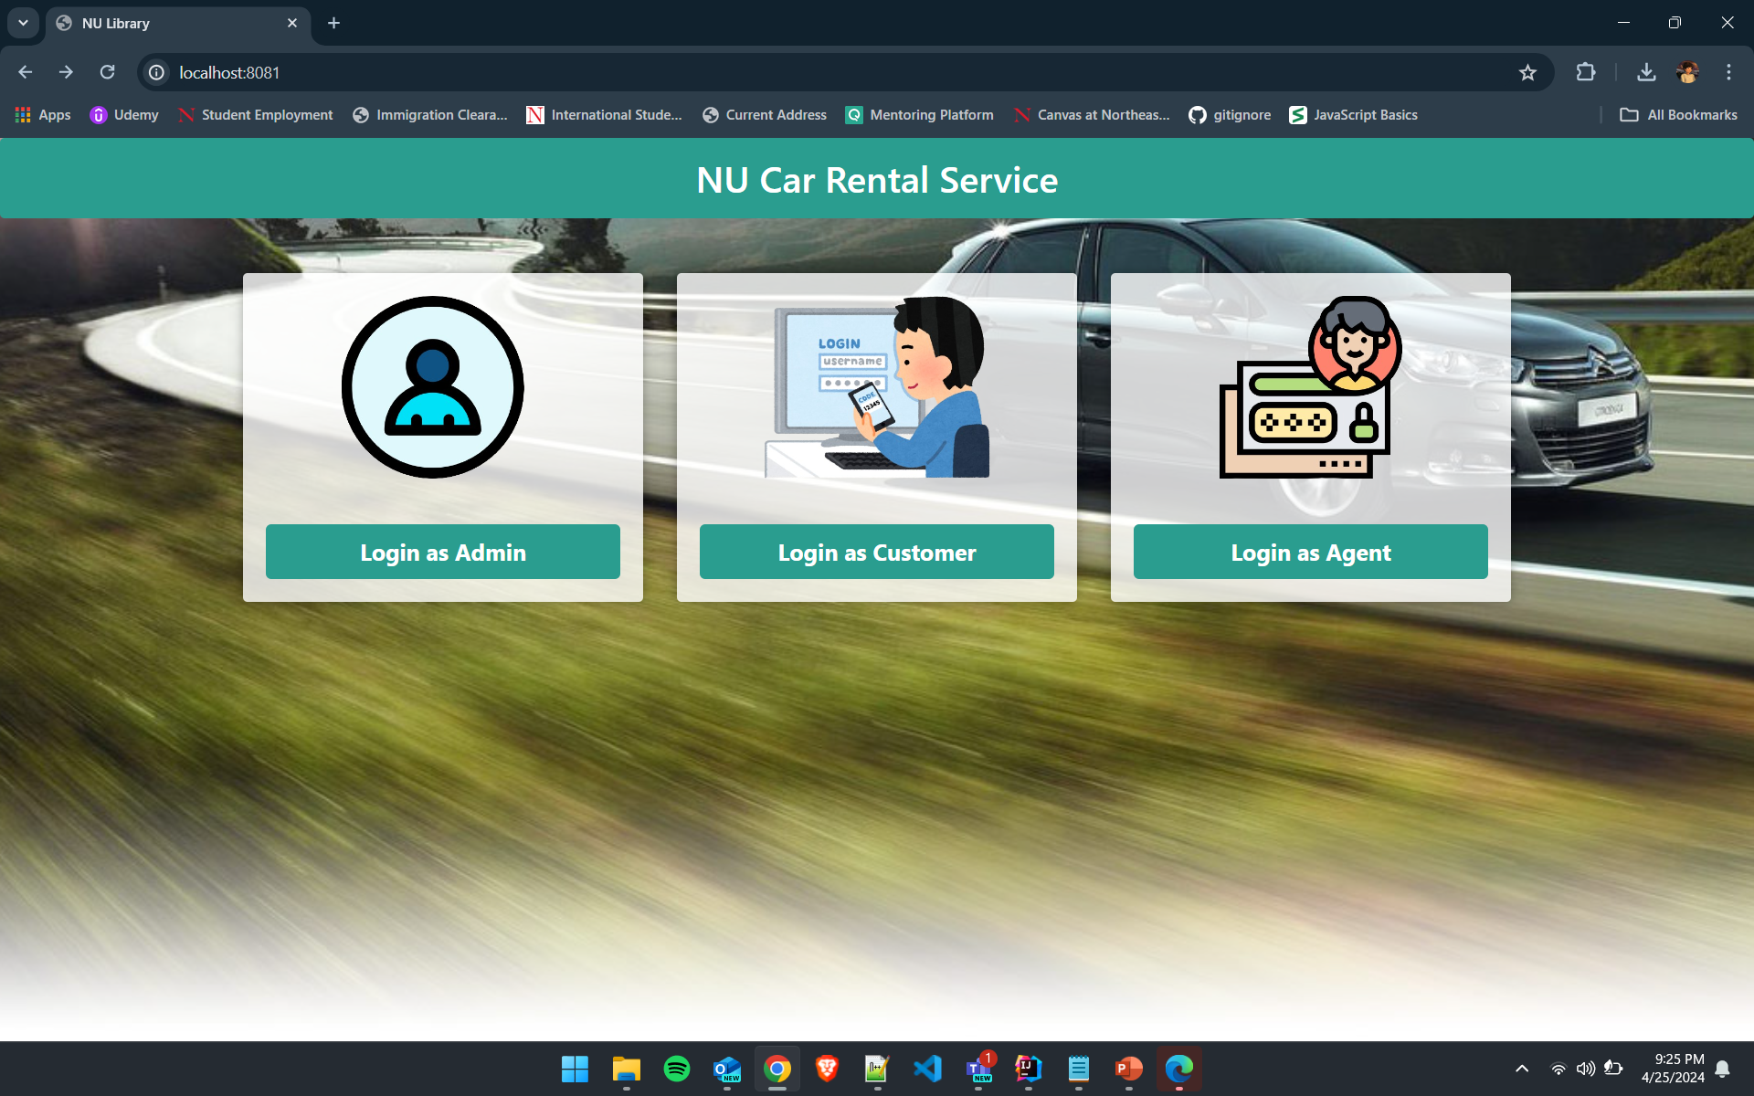

Slide 3
Team Members
Amit Singh Tomar
Aniket Vaman Navale
Mohit Jain
Shravya Gunda
Tejas Choudhari

Slide 4

NU Rentals
Frontend: HTML, CSS, Bootstrap
Backend: Java, Spring Boot

Slide 5
Key Features
Seamless Car Booking Process
Diverse Car Selection
Flexible Rental Duration
Integration with Driving Class Appointment Booking

Slide 6
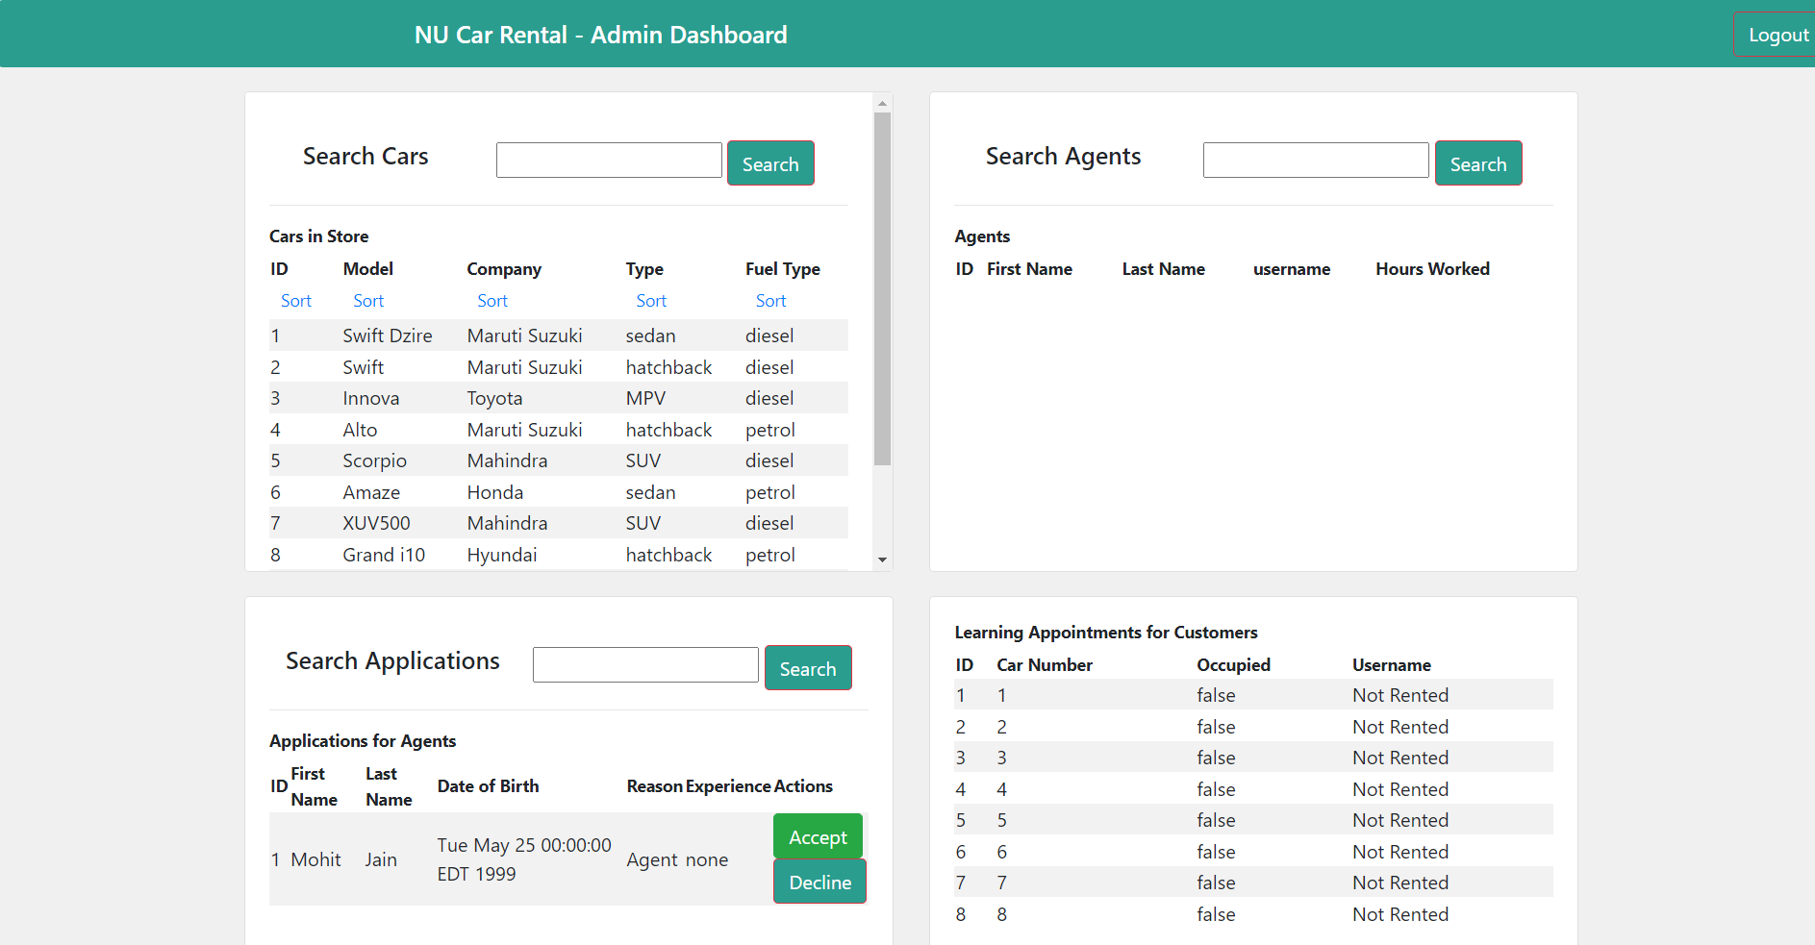
Admin

Slide 7
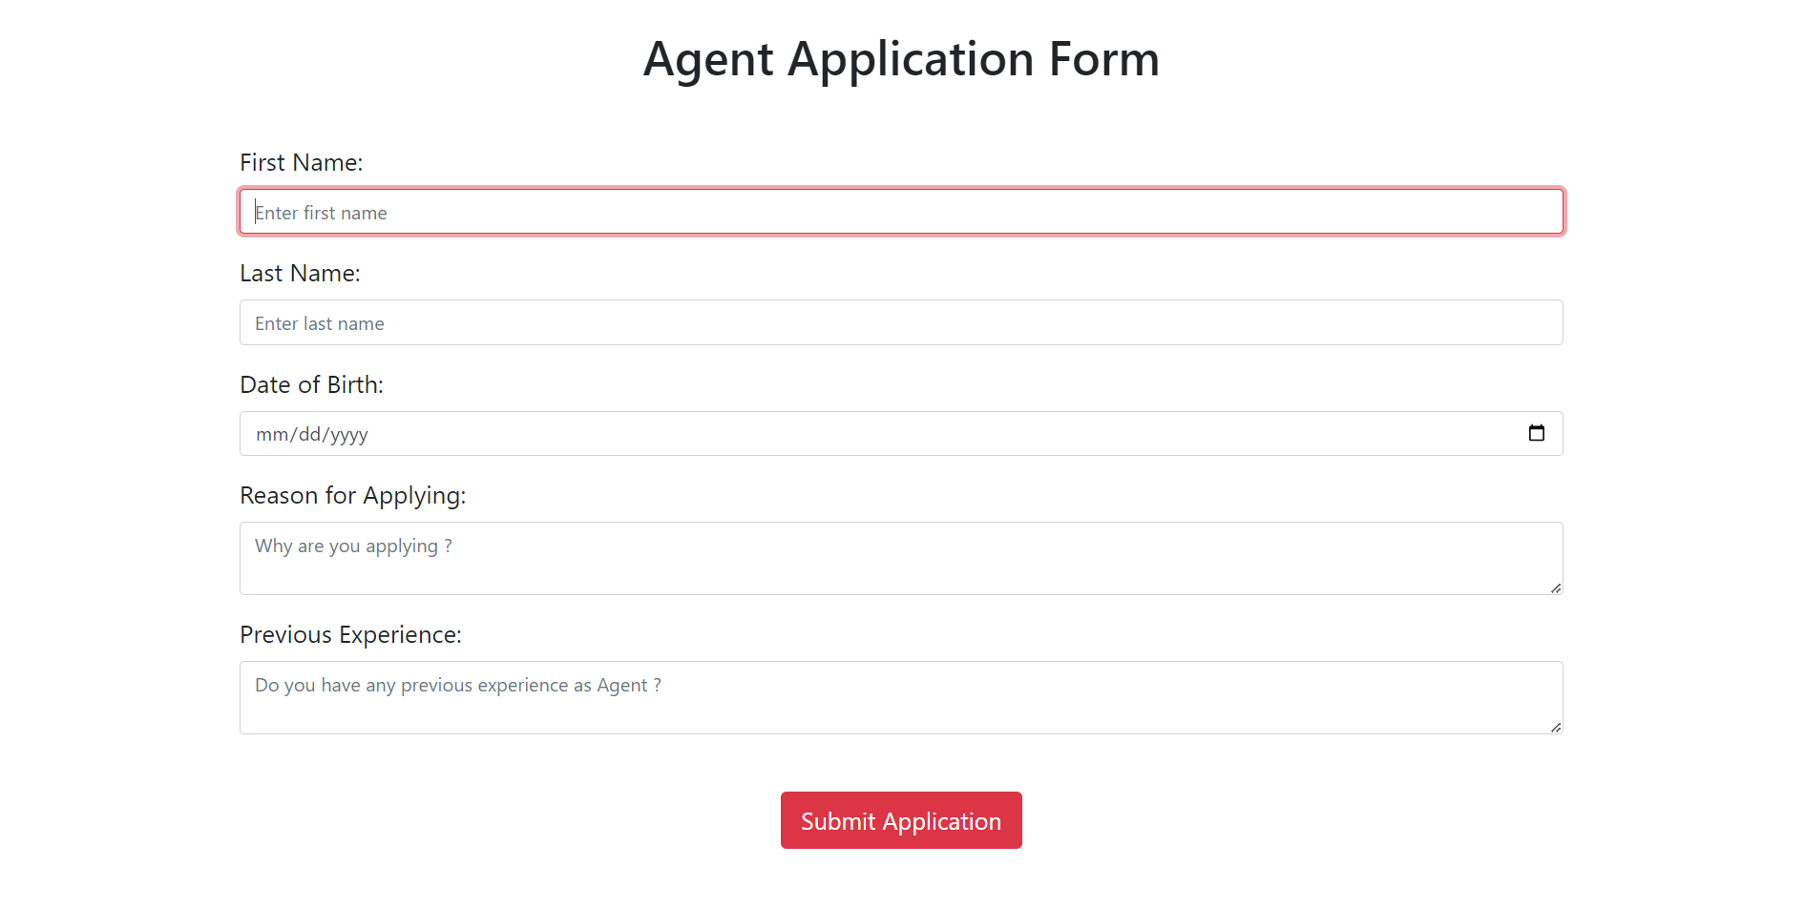
Agent Sign Up

Slide 8
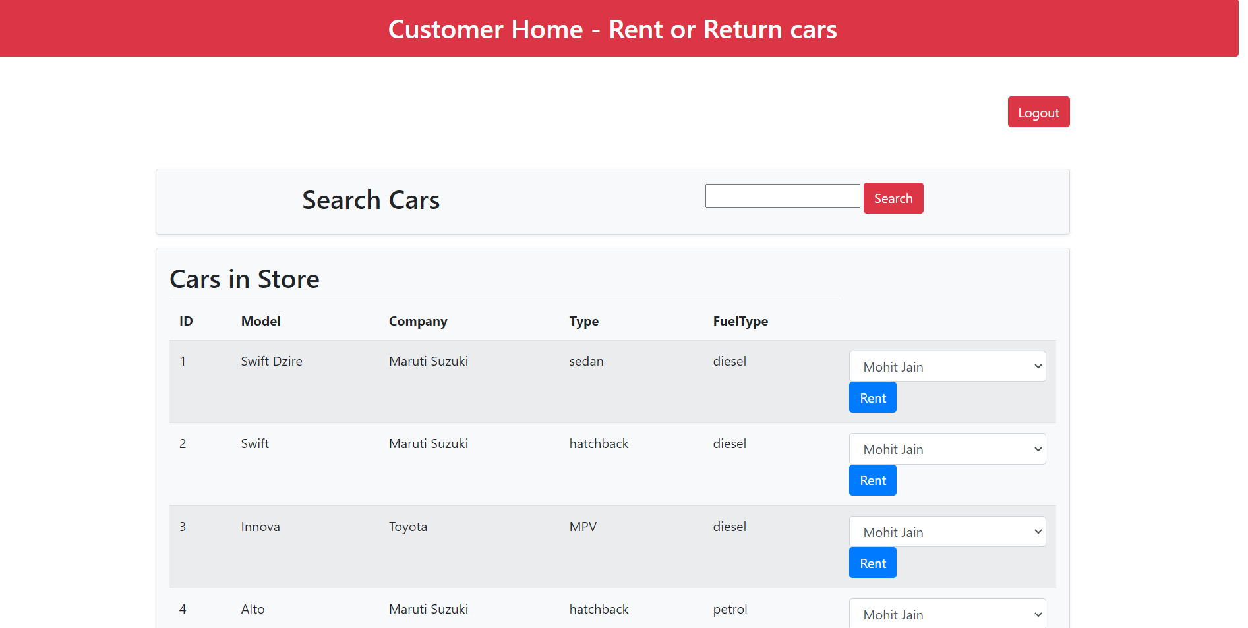
Customer Login

Slide 9
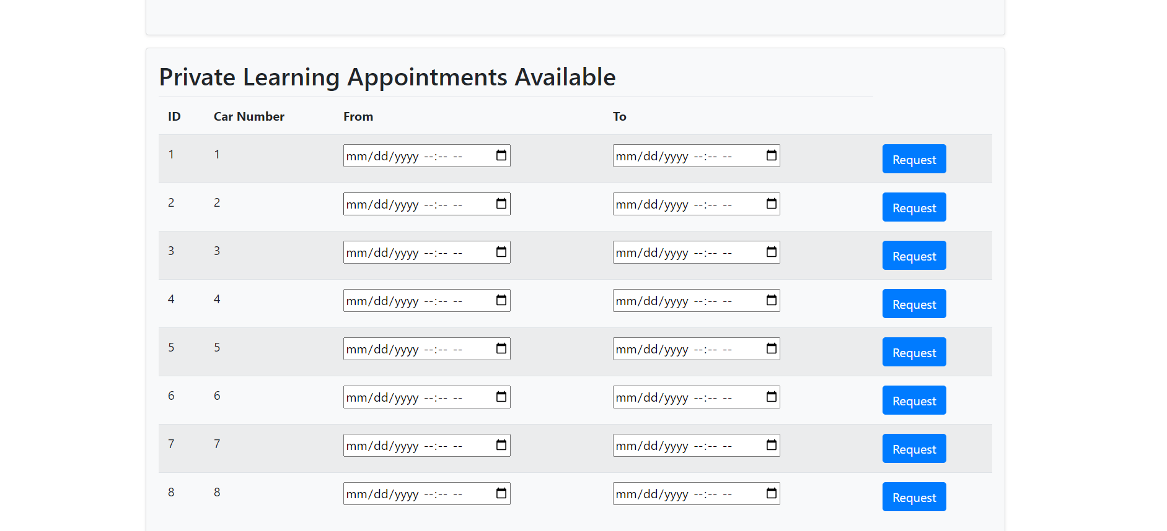
Learning Appointment Booking

Slide 10
Thank You

